Slide 1
Where is God leading us?
Preached by Dr. Jim Harmeling at Crossroads International Church Singapore • CICFamily.com Uploaded by Dr. Rick Griffith • Singapore Bible College Files in many languages for free download at BibleStudyDownloads.org

Slide 2
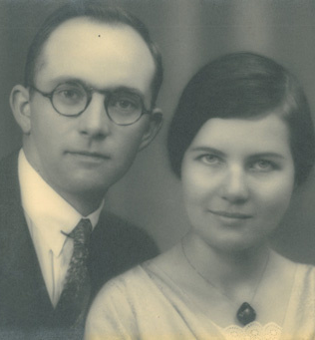
“The faithfulness of God is the only certain thing in the world today. We need not fear the result of trusting Him.”
John Stam

Slide 3
Recall our Joy

Slide 4
Acts 2:42
And they devoted themselves to the apostles’ teaching and the fellowship, to the breaking of bread and the prayers.
Teaching
Fellowship/Care
Ministry

Slide 5
Recall our Joy
Reaffirm our Foundation

Slide 6
2 Peter 1:12-13
Therefore I intend always to remind you of these qualities, though you know them and are established in the truth that you have. ¹³ I think it right, as long as I am in this body, to stir you up by way of reminder.
Sound gospel theology
PIE Values

Slide 7
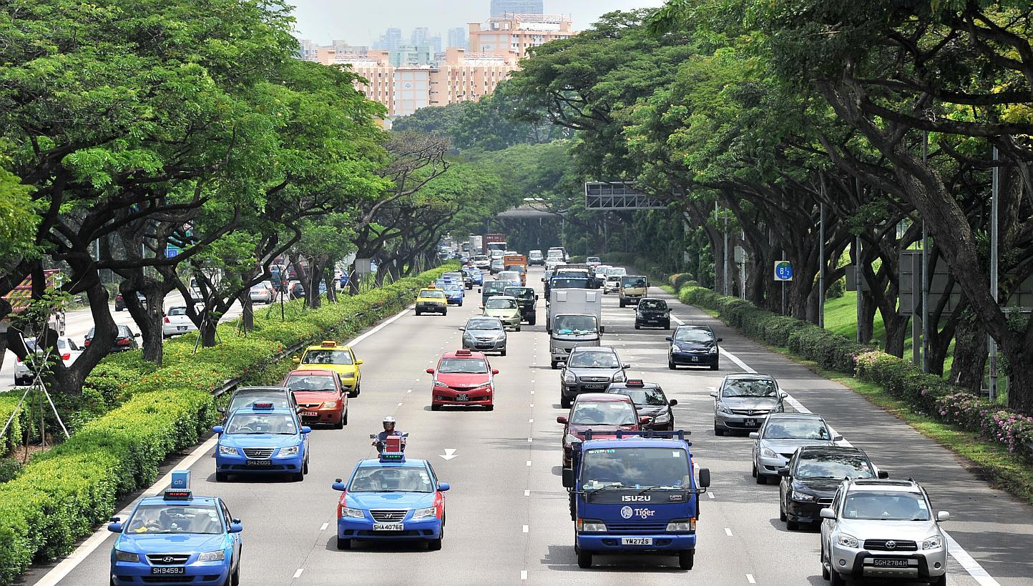
PIE
Passionate
International
Expository

Slide 8
Recall our Joy
Reaffirm our Foundation
Rise to our Challenge

Slide 9
Love God
Love the Church
Ministering
Create
Manage
Explore & Risk

Slide 10
Love God
Love the Church
Giving
Start
Increase

Slide 11
Love God
Love the Church
Loving
Family focus
Care Team

Slide 12
Philippians 1:9-11
⁹ And it is my prayer that your love may abound more and more, with knowledge and all discernment, ¹⁰ so that you may approve what is excellent, and so be pure and blameless for the day of Christ, ¹¹ filled with the fruit of righteousness that comes through Jesus Christ, to the glory and praise of God.

Slide 13
1 Thessalonians 3:12-13
¹² and may the Lord make you increase and abound in love for one another and for all, as we do for you, ¹³ so that he may establish your hearts blameless in holiness before our God and Father, at the coming of our Lord Jesus with all his saints.

Slide 14
Love God
Love the Church
Love the Nations
Deliberate discipleship
Hands on Missions

Slide 15
Where is God leading us?

Slide 16
Black

Slide 17
Topical Preaching link at BibleStudyDownloads.org
Get this presentation for free!
Notes:
The Bible…Basically (bb)

